Slide 1
Project Presentation: ADBMS
Hotel Management System
By:
Anshula Sharma
2K21/CSE/07

Slide 2
Introduction
A project to create a Hotel Management System which will make booking a hotel a seamless and hassle-free experience.
It provides a smooth experience to the admin, who is able to view all the information regarding rooms, reservations and users currently using the system.
The hotel management project make it easier to manage rooms in a hotel.

Slide 3
FUNCTIONALITY
Customers:
Users will be able to browse through the available rooms.
They will be able to create bookings.
They will be able to check all their previous bookings.
Admin:
Admin will be able to view all the rooms.
Add, Edit and Delete rooms.
Check all the users and all the current and previous bookings made.

Slide 4
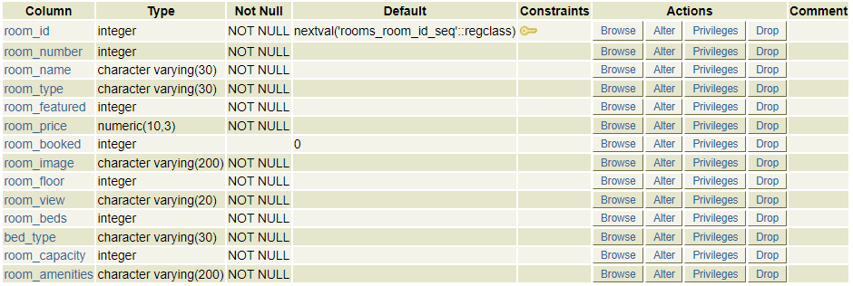
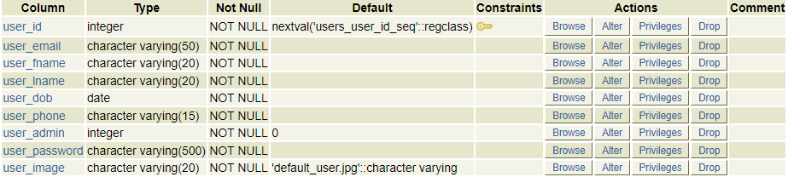
Database Tables
Rooms Table
Users Table

Slide 5
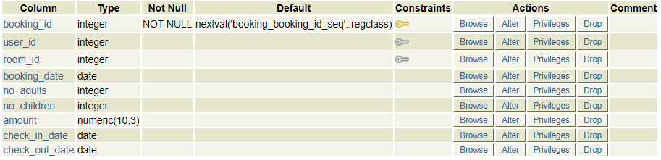
Booking Table

Slide 6
Requirements
Development Tools:
  Front End : HTML, CSS, JAVASCRIPT, JQUERY, BOOTSTRAP
  Back End : PHP, PostgreSQL
Operating System : Windows 10
Web server : WAPP by Bitnami
Text Editor: VS Code

Slide 7
PROGRESS
Completed:
All the tables to be used for the website have been created.
Users can access the website and browse through all the available rooms, create bookings, check all their previous bookings.
Admin can manage the details of the room, add new rooms, delete rooms, view users and check reservations.

Slide 8
In Progress:
Designing related to user dashboard
Designing related to admin dashboard.
Designing related to login page and register page.

Slide 9
THANK YOU

